Slide 1
Government Polytechnic, Bramhapuri.
Department of Computer Technology
Project Title :-
AR and VR based Educational Software.
Guided By :
Prof. S.I.Bansod
Group Members :
Sagar Bishwas
Pranjali Bramhankar
Gourav Kolhatkar

Slide 2
Problem Definition

Slide 3


Slide 4
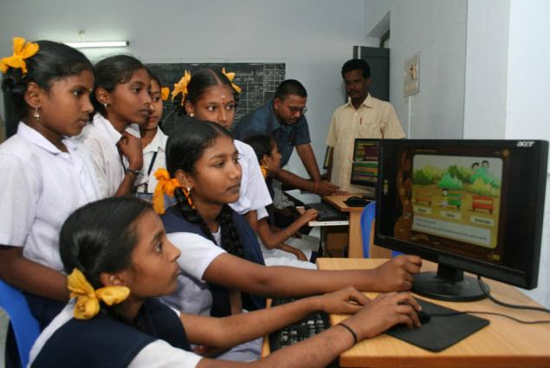

Slide 5



Slide 6


Slide 8
Introducing
Augmented Reality Based Software for education

Slide 9
Augmented Reality is an interactive experince of a real–world environment where the object that reside in the real world are “Build Up” by computer generated information, sometimes across multiple sensory modalities, including visuals, camera and Haptics.
What is Augmented Reality ?

Slide 10
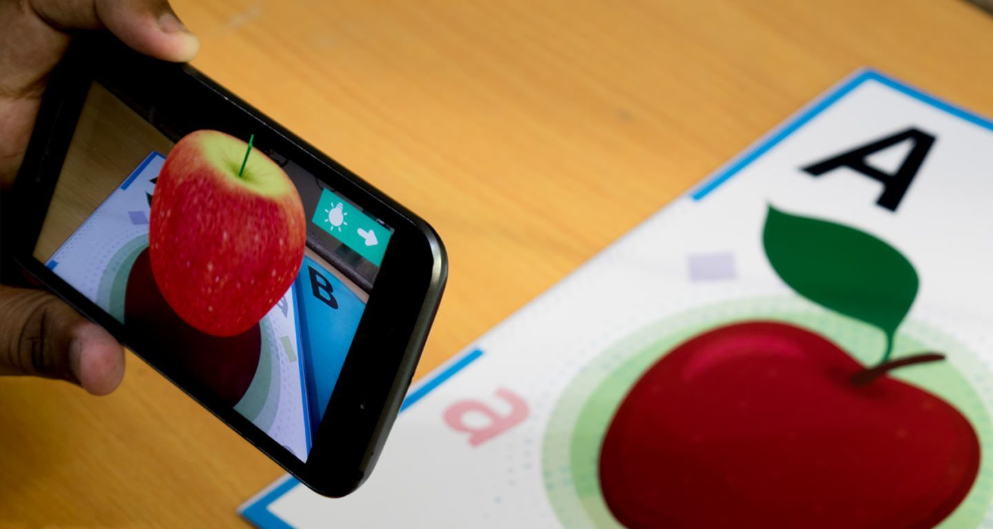

Slide 11
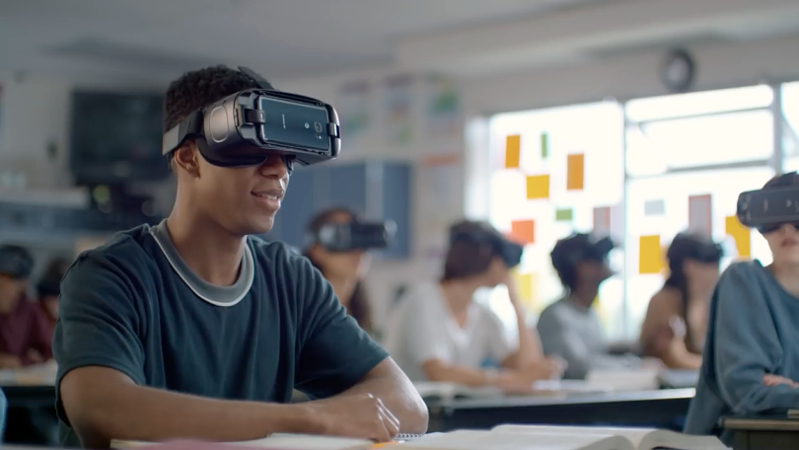

Slide 12
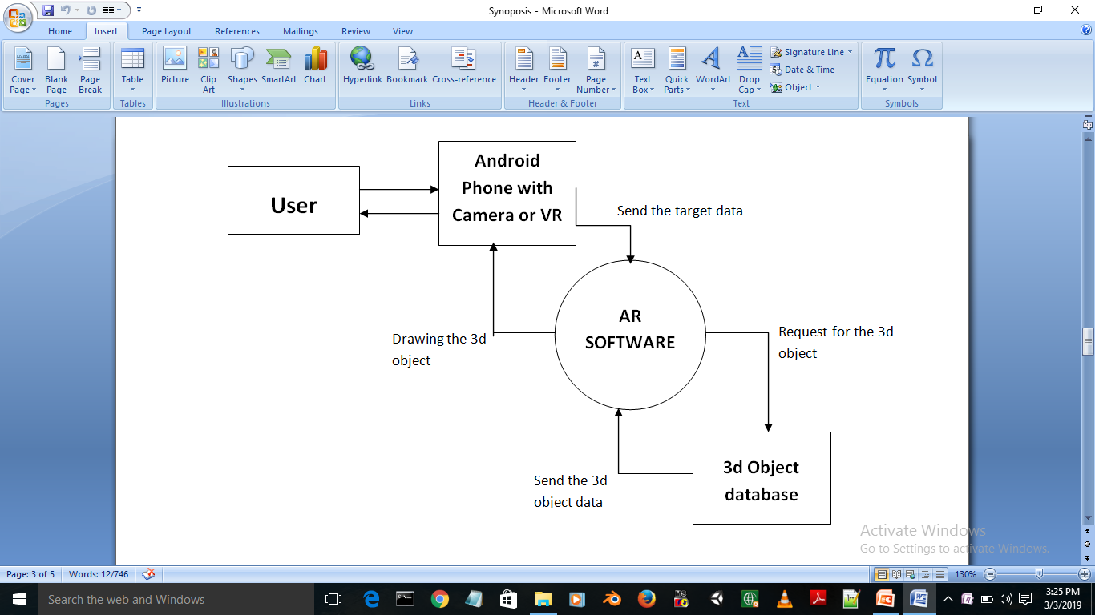
Fig. DFD Diagram Level 1

Slide 13
Graphical User Interface
Vuforia (AR Module)
C# Scripts
3d Models
Modules

Slide 14

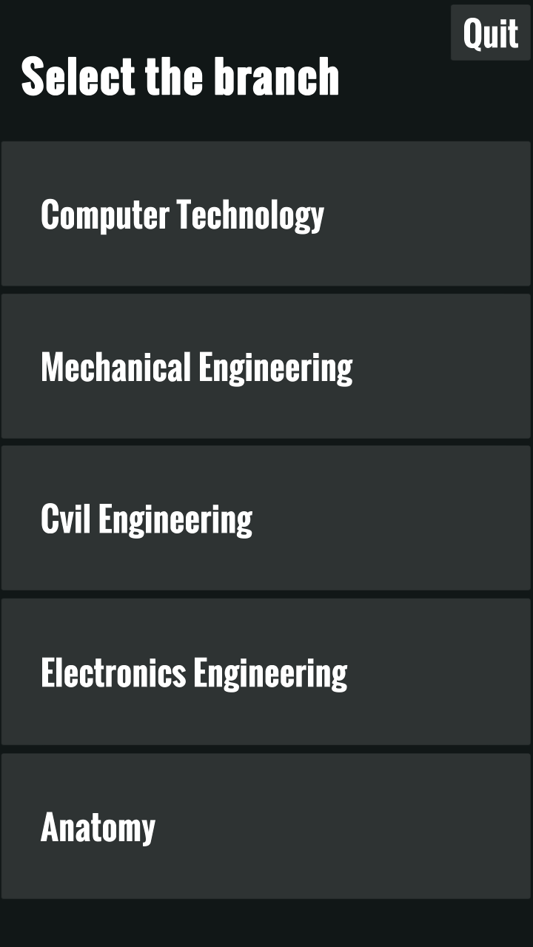
Label
Buttons

Slide 15
(Vuforia) AR Module

Slide 16


Slide 17
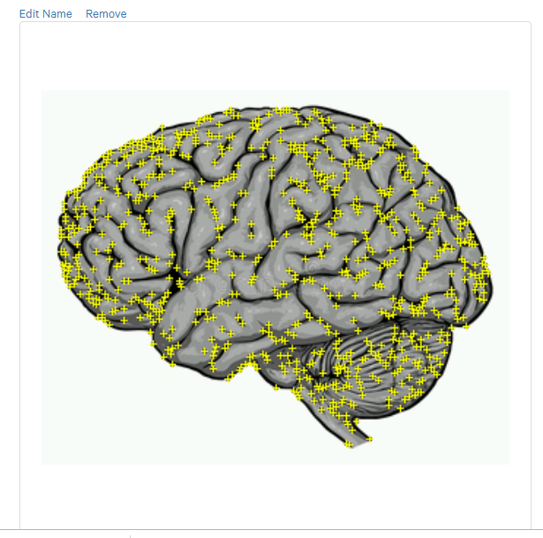

Processed Image

Slide 18
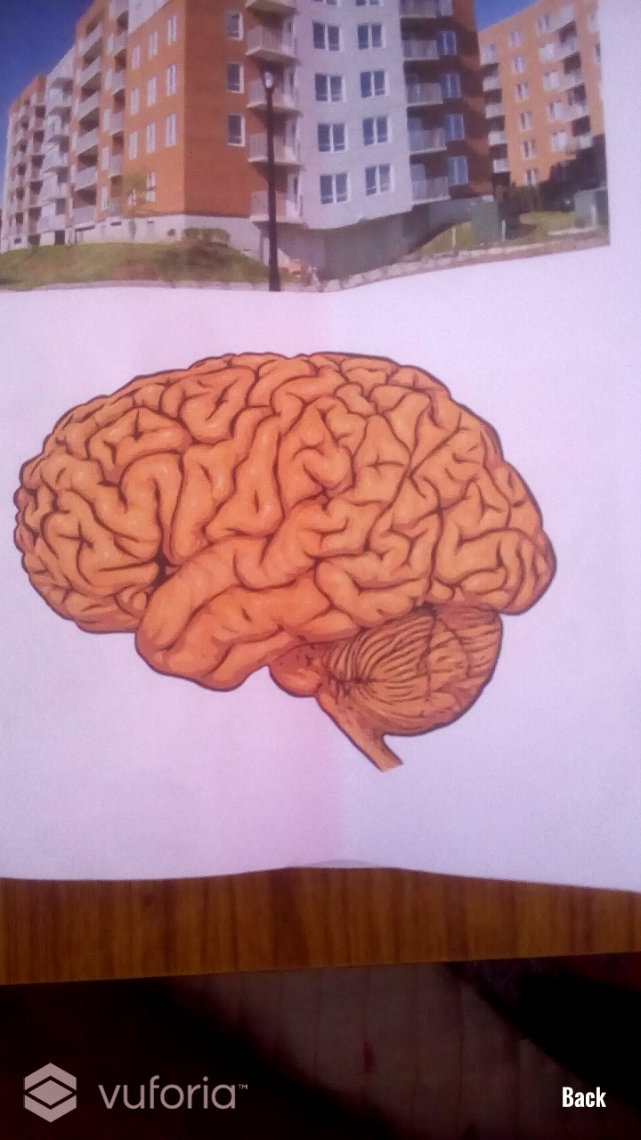
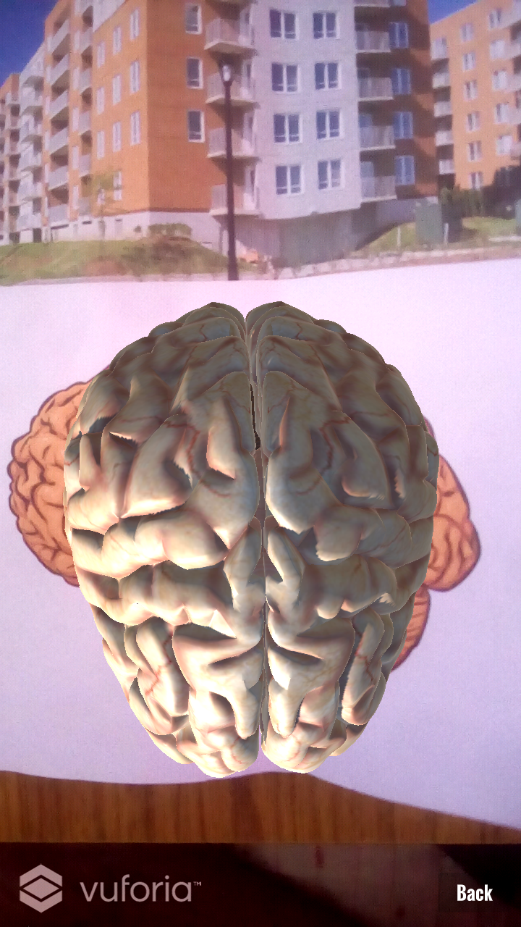
After Processing and Detecting
the Image target

Slide 19
A survey published in The State of the Developer Nation Q1 report puts C# and C/C++ as the most used programming languages for AR/VR development. This is not a coincidence.
Main Menu
Event Handling
Fade Animation
C# Scripts

Slide 20
3D Models

Slide 21
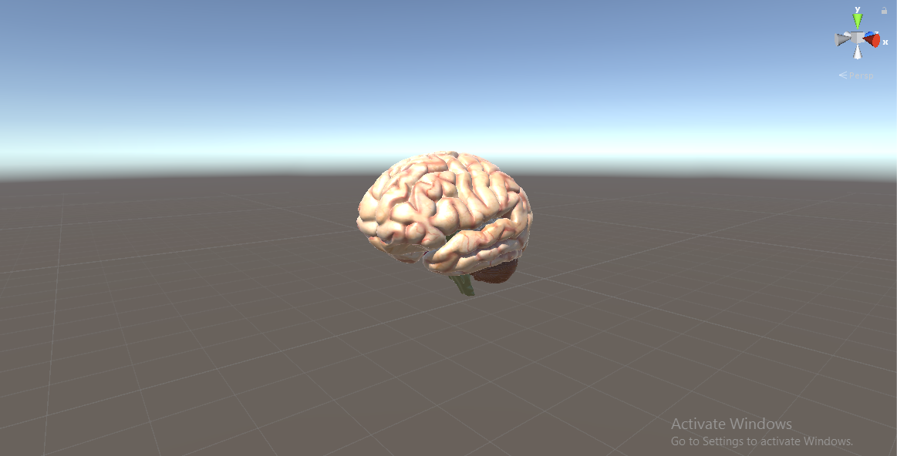

Slide 22
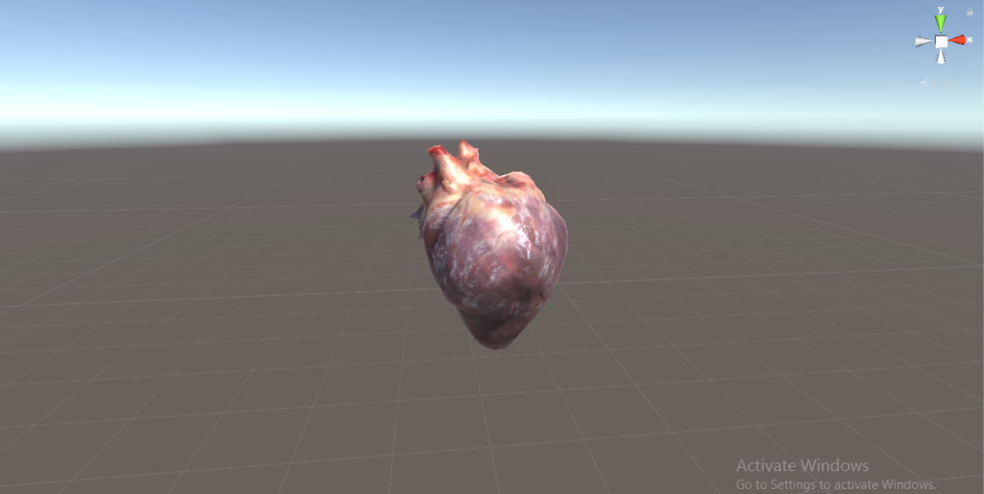

Slide 23
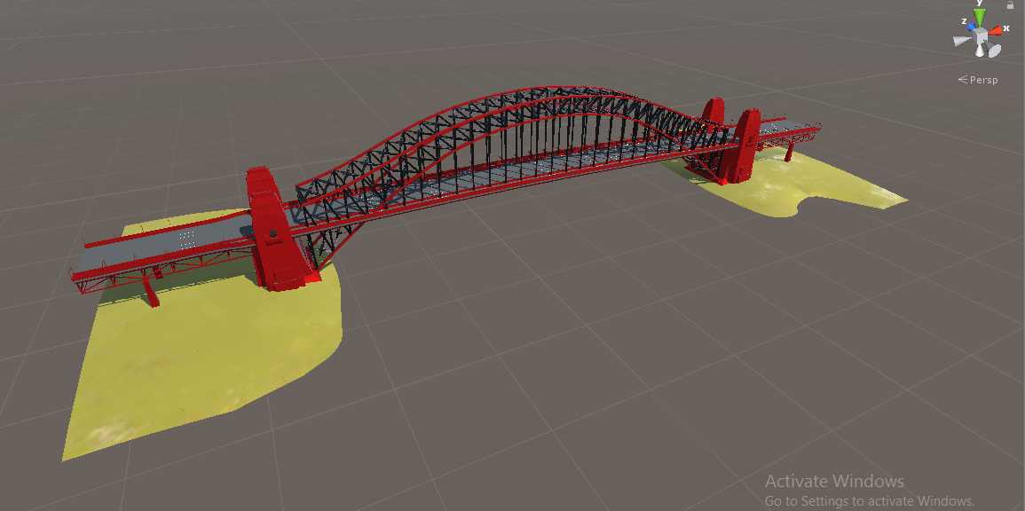

Slide 24
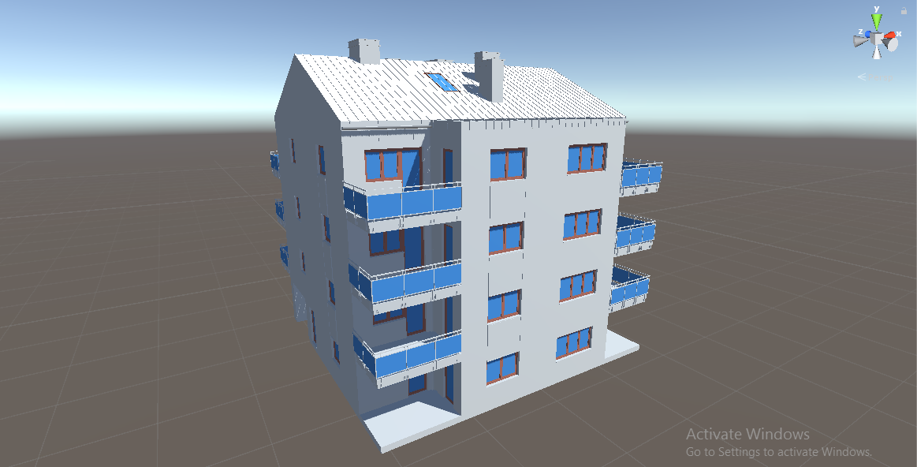

Slide 25
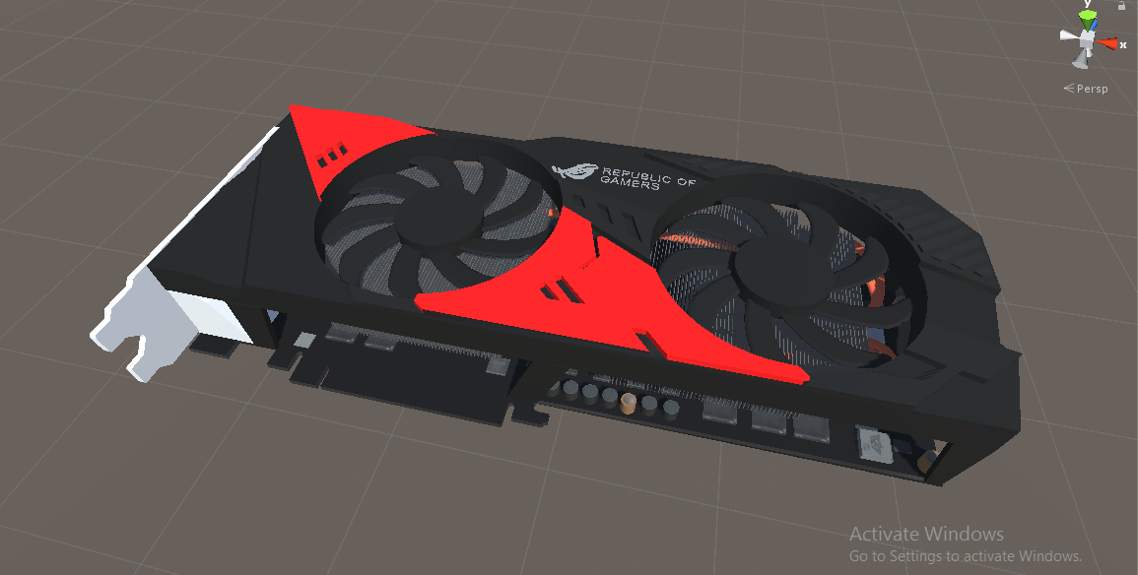

Slide 26
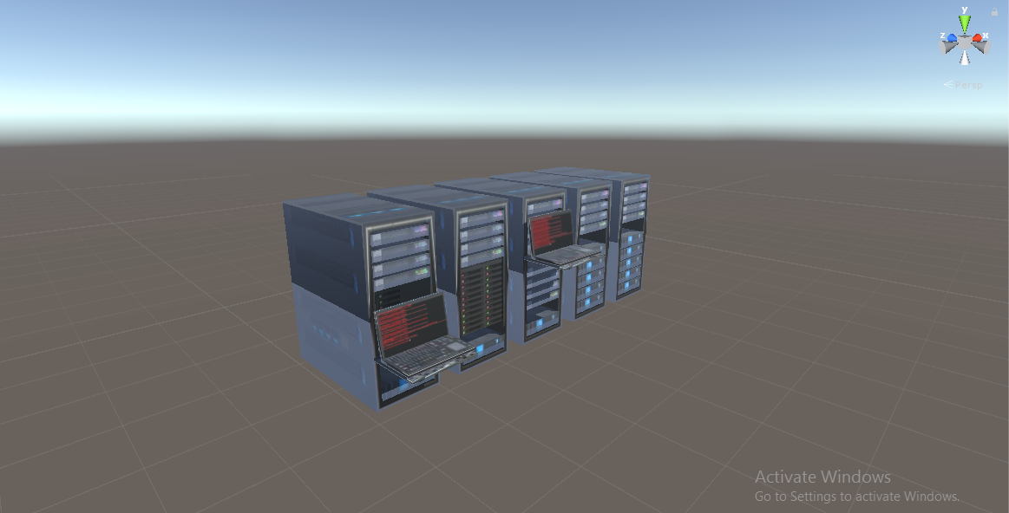

Slide 27
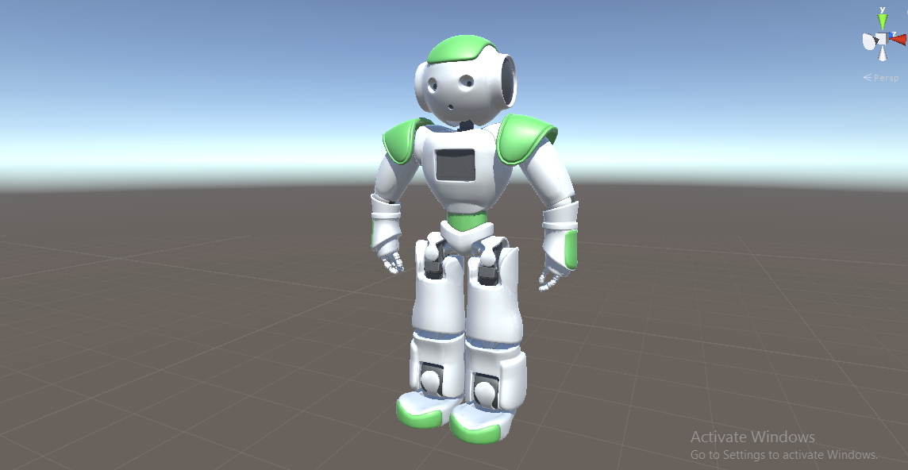

Slide 28
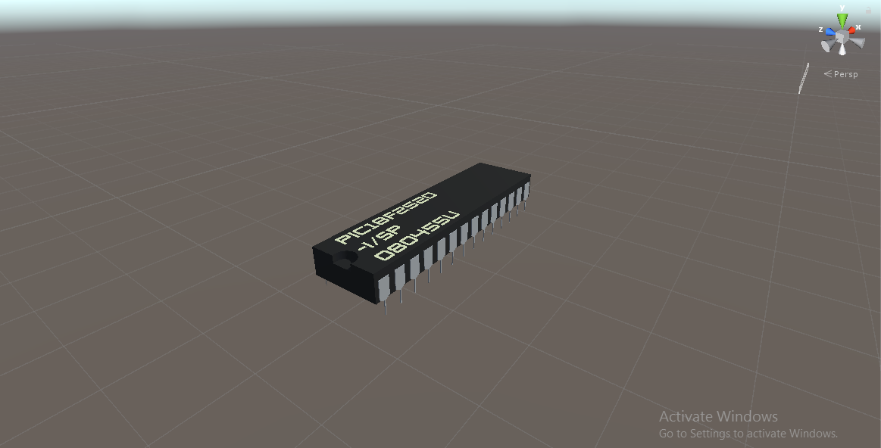

Slide 29
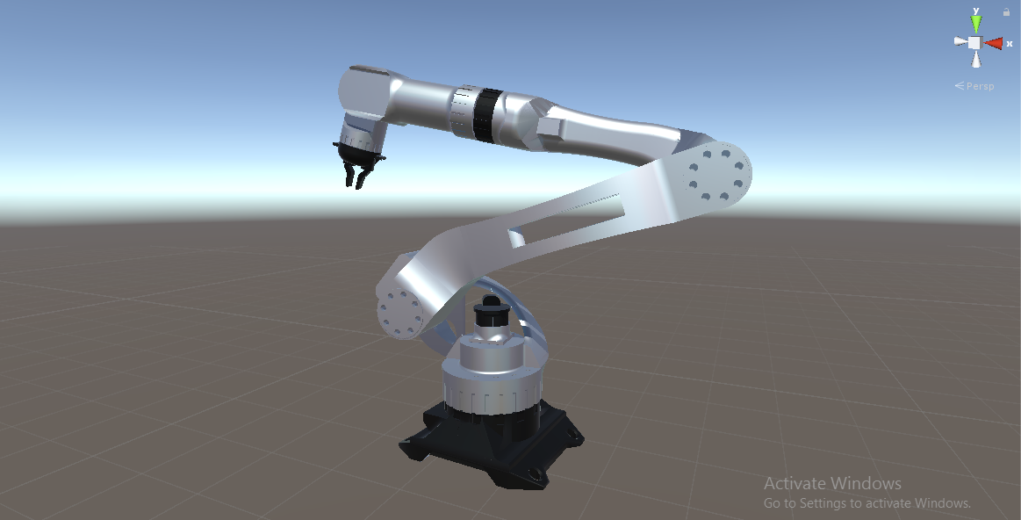

Slide 30
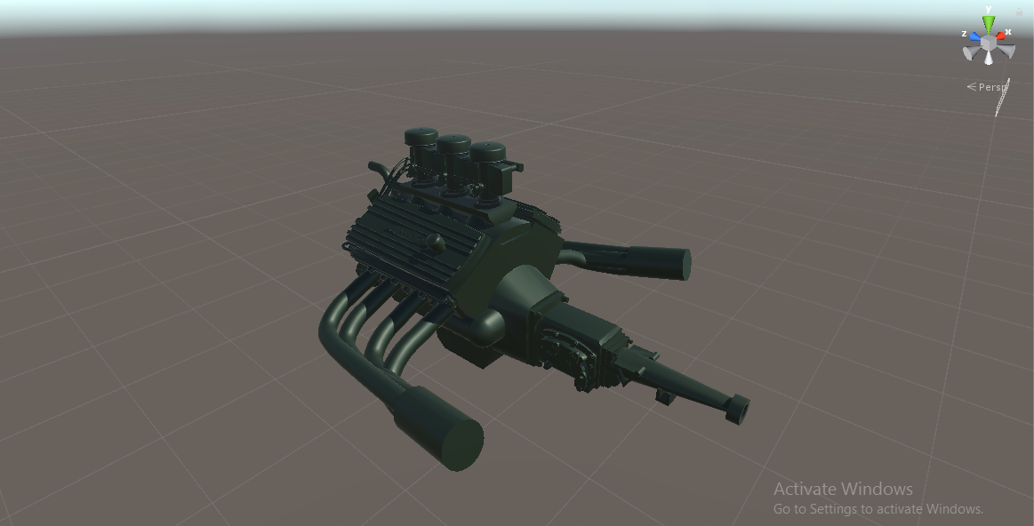

Slide 31
Application and Future Scope

Slide 32
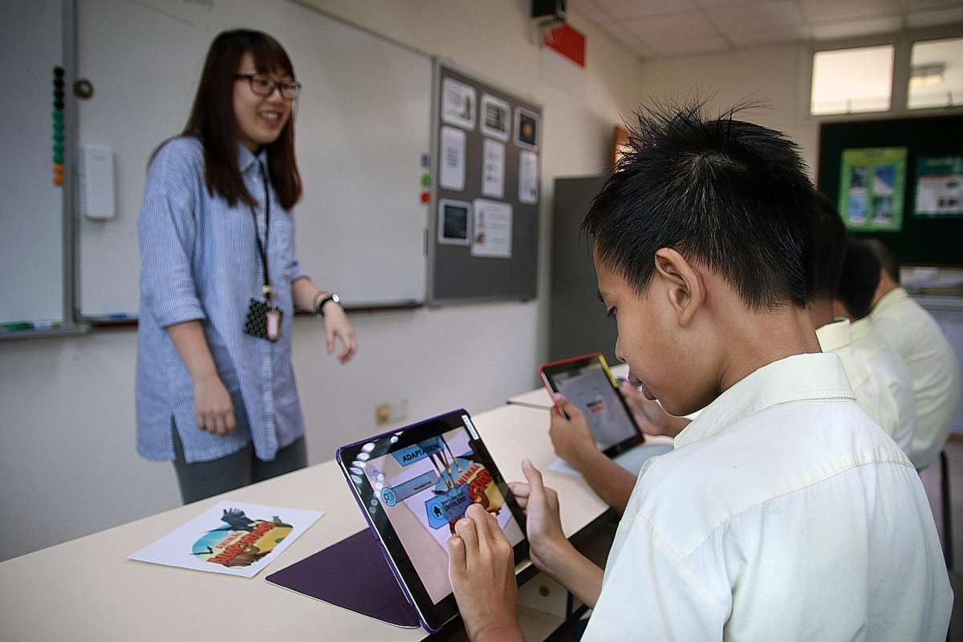

Slide 33
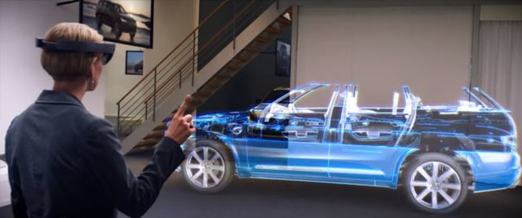

Slide 34
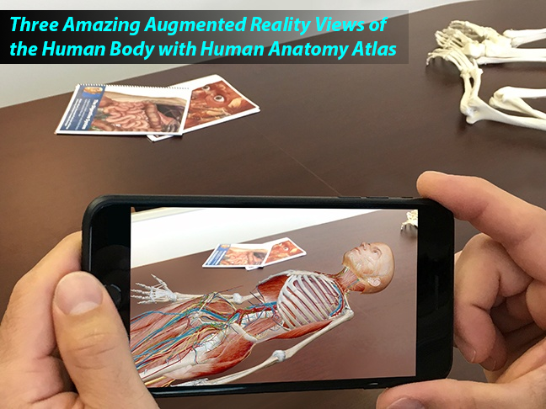

Slide 35
The AR system is highly interactive in nature and operates simultaneously with real time environment.
It reduces line between real world and virtual world.
It enhances perceptions and interactions with the real world.
It can be applied to part of practicals as it makes things memorable and eye catching.
Advantages

Slide 36
A need of extra wearable device :
Since users may want to feel more authenticity in AR, wearable devices such as Google Glass and Apple’s iWatch may be provided for users in order to offer authentic experiences in more convenient yet expansive way.
Technical Failure :
Technical failures like camera not working, damaged screen or Low battery of mobile phone may cause trouble while using the application.
Disadvantages

Slide 37
Thank You !

